Slide 1


JEOPARDY JEOPARDY JEOPARDY JEOPARDY JEOPARDY JEOPARDY JEOPARDY JEOPARDY JEOPARDY JEOPARDY JEOPARDY JEOPARDY JEOPARDY JEOPARDY JEOPARDY JEOPARDY JEOPARDY JEOPARDY JEOPARDY
JEOPARDY JEOPARDY JEOPARDY JEOPARDY JEOPARDY JEOPARDY JEOPARDY JEOPARDY JEOPARDY JEOPARDY JEOPARDY JEOPARDY JEOPARDY JEOPARDY JEOPARDY JEOPARDY JEOPARDY JEOPARDY JEOPARDY
Notes:
Family Feud Template
Introduction Slide – Family Feud!

Slide 2
FAQ:
Q. How do I reset the links on the main board back to yellow?
A. Simply close the PowerPoint file, and re-open, and the links will turn back to yellow.
Q. Why aren’t the sound effects working?
A. If the sound effects aren’t working, I would suggest upgrading your PowerPoint to something newer than 2008, and using a PC instead of a Mac if possible. Also, Google slides, Keynotes, etc. are not supported.
Q. Can I get a board with less categories? Can I add a custom logo?
A. Unfortunately these changes are a little too complex for me to explain or assist you via email, but if you’d like me to do a custom job for you for a small fee, send me an email at Reid@youthdownloads.com.
Notes:
Family Feud Template
Introduction Slide – Family Feud!

Slide 3
HERE ARE TODAY’S CATEGORIES
Notes:
Family Feud Template
Introduction Slide – Family Feud!

Slide 4

PRESENT PASSIVE

Slide 5
PAST PASSIVE

Slide 6
PRESENT PERFECT PASSIVE

Slide 7
PAST PERFECT PASSIVE

Slide 8
PRESENT-PAST CONTINUOUS PASSIVE

Slide 9
FUTURE PASSIVE

Slide 10

PRESENT PERFECT PASSIVE
PAST PERFECT PASSIVE
PRESENT- PAST CONTINUOUS PASSIVE
FUTURE PASSIVE
PRESENT PASSIVE
PAST PASSIVE
$100
$100
$100
$100
$100
$100
$200
$200
$200
$200
$200
$200
$300
$300
$300
$300
$300
$300
$400
$400
$400
$400
$400
$400
$500
$500
$500
$500
$500
$500
FINAL JEOPARDY

Slide 11
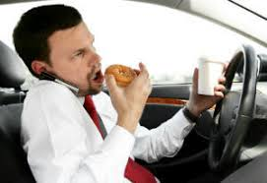
Change this active sentence into Present Passive:
Careless driving cause many accidents.

Slide 12
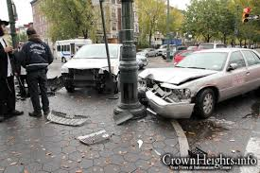
Many accidents are caused by careless driving.

Slide 13
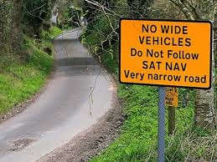
Change this active sentence into Present Passive:
People don’t use this road much.

Slide 14
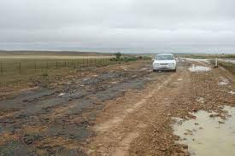
This road isn’t used much by people.

Slide 15
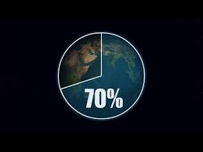
Change this active sentence into Present Passive:
Water covers most of the earth’s surface.

Slide 16

Most of the earth’s surface is covered by water.

Slide 17
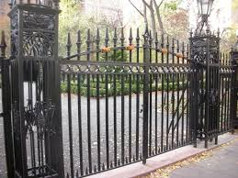
Change this active sentence into Present Passive:
They lock the park gates at 6:30 p.m. every evening.

Slide 18
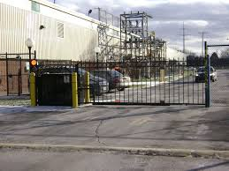
The park gates are locked at 6:30 p.m. every evening.

Slide 19

Change this active sentence into Present Passive:
How do people learn languages?

Slide 20

How are languages learnt by people?

Slide 21

Change this active sentence into Past Passive:
The company employed two hundred people.

Slide 22

Two hundred people were employed by the company.

Slide 23
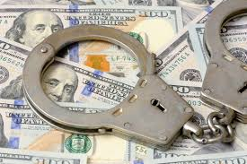
Change this active sentence into Past Passive:
Somebody stole a lot of money in the robbery.

Slide 24
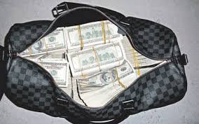
A lot of money was stolen in the robbery.

Slide 25
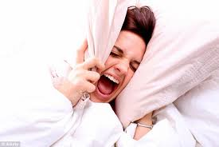
Change this active sentence into Past Passive:
A loud noise woke us up during the night.

Slide 26
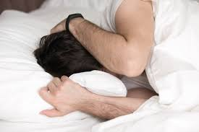
We were woken up by a loud noise during the night.

Slide 27
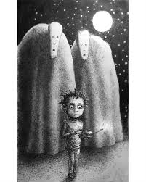
Change this active sentence into Past Passive:
People warned us not to go out alone.

Slide 28

We were warned not to go out alone.

Slide 29

Change this active sentence into Past Passive:
Where did you take these pictures?

Slide 30
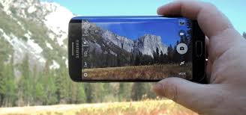
Where were these pictures taken?

Slide 31
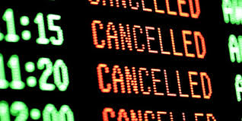
Change this active sentence into Present Perfect Passive:
They have cancelled the trip.

Slide 32
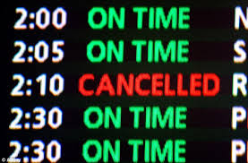
The trip has been cancelled.

Slide 33
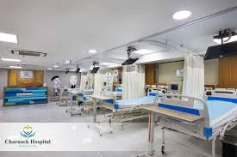
Change this active sentence into Present Perfect Passive:
They have built a new hospital near the airport.

Slide 34
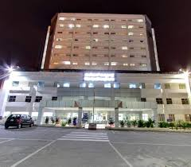
A new hospital has been built near the airport.

Slide 35

Change this active sentence into Present Perfect Passive:
They have never given me flowers on my birthday.

Slide 36

I have never been given flowers on my birthday.

Slide 37
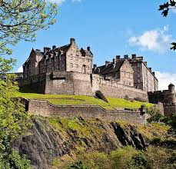
Change this active sentence into Present Perfect Passive:
Many tourists have visited that castle.

Slide 38
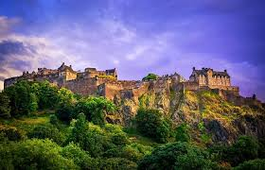
That castle has been visited by many tourists.

Slide 39

Change this active sentence into Present Perfect Passive:
Has anybody shown you what to do?

Slide 40
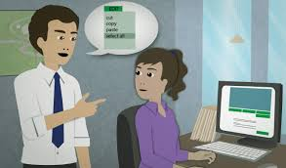
Have you been shown what to do?

Slide 41

Change this active sentence into Past Perfect Passive:
Chloe had cooked meal.

Slide 42

Meal had been cooked by Chloe.

Slide 43

Change this active sentence into Past Perfect Passive:
They had not written a letter.

Slide 44

A letter had not been written by them.

Slide 45
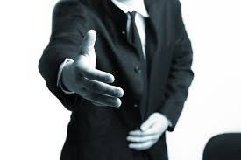
Change this active sentence into Past Perfect Passive:
Had I helped you?

Slide 46

Had you been helped by me?

Slide 47
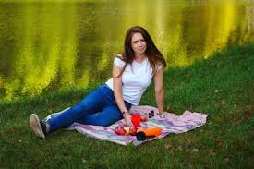
Change this active sentence into Past Perfect Passive:
Had she made a picnic plan?

Slide 48
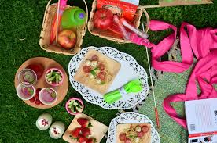
Had a picnic plan made by her?

Slide 49
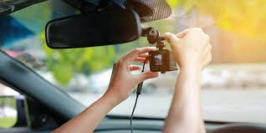
Change this active sentence into Past Perfect Passive:
They had just set up the camera because of the accidents.

Slide 50
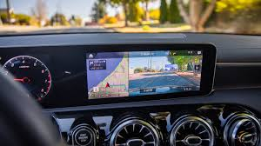
The camera had just been set up because of the accidents.

Slide 51
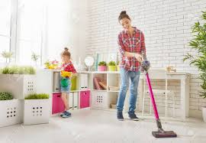
Change this active sentence into Present Continuous Passive:
Somebody is cleaning the room at the moment.

Slide 52
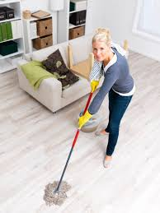
The room is being cleaned at the moment.

Slide 53
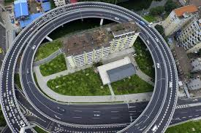
Change this active sentence into Past Continuous Passive:
They were building a new ring road round the city.

Slide 54
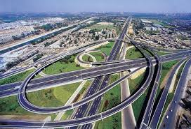
A new ring road was being built round the city.

Slide 55

Change this active sentence into Present Continuous Passive:
Somebody is using the computer right now.

Slide 56
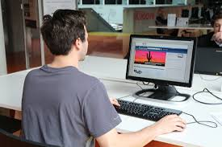
The computer is being used right now.

Slide 57
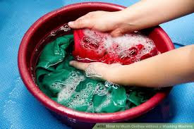
Change this active sentence into Past Continuous Passive:
She was not washing a shirt.

Slide 58
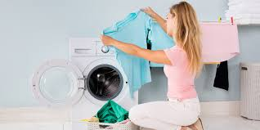
A shirt was not being washed by her.

Slide 59


Slide 60
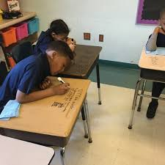
Change this active sentence into Past Continuous Passive:
What was he writing on the desk?

Slide 61

What was being written by him on the desk?

Slide 62
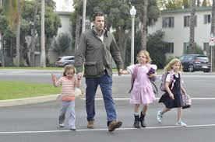
Change this active sentence into Future Passive:
Will he pick up the kids tomorrow?

Slide 63
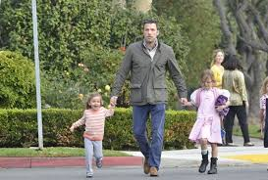
Will the kids be picked up tomorrow?

Slide 64
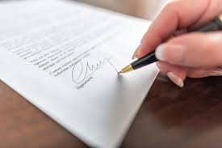
Change this active sentence into Future Passive:
Will the manager sign the contract next week?

Slide 65
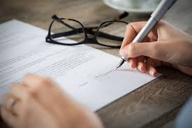
Will the contract be signed by the manager next week?

Slide 66

Change this active sentence into Going to Future Passive:
The police are going to investigate the case.

Slide 67

The case is going to be investigated by the police.

Slide 68
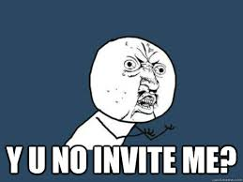
Change this active sentence into Going to Future Passive:
Is anybody going to invite me?

Slide 69

Am I going to be invited by anybody?

Slide 70
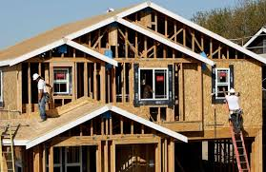
Change this active sentence into Future Passive:
Where will he build a new house next year?

Slide 71
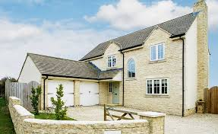
Where will the house be built next year?

Slide 72


Slide 73
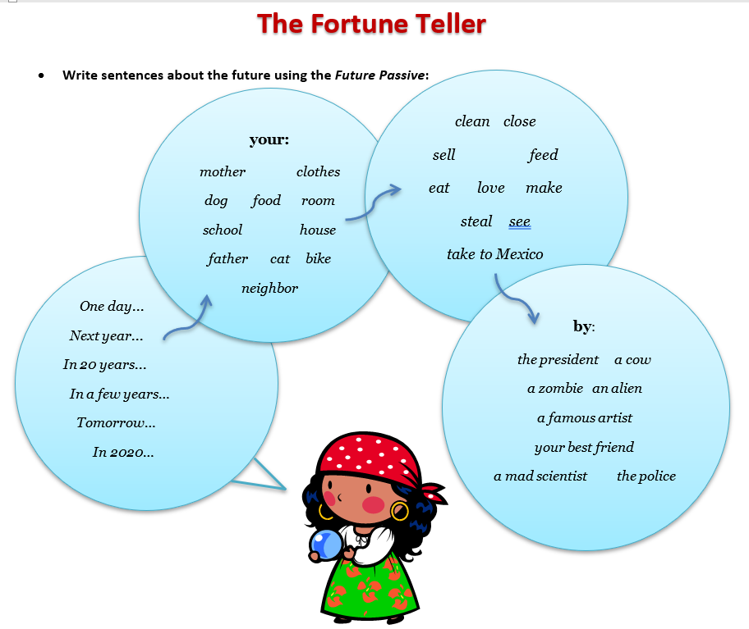
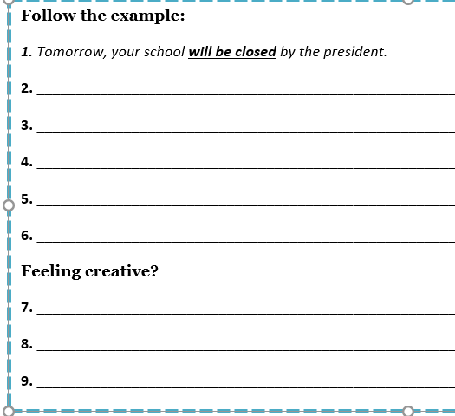
Start Timer
GO TO
ANSWER
(question)

