Slide 1
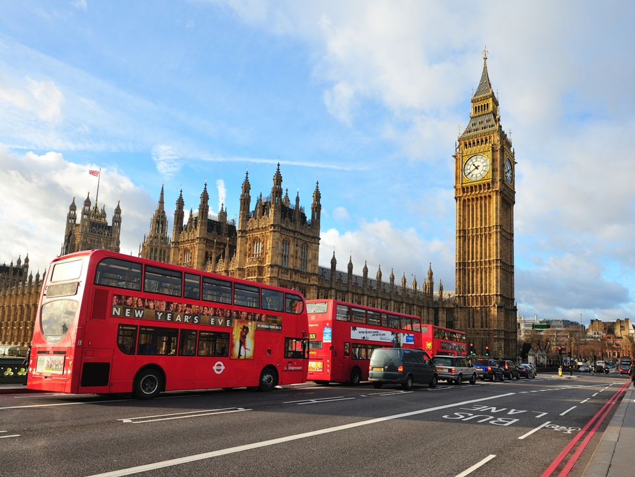
SOME VIEWS ON THE ENGLISH CHARACHTER
Выполнила:
учитель английского языка
Кузовова Карина Геннадьевна

Slide 2

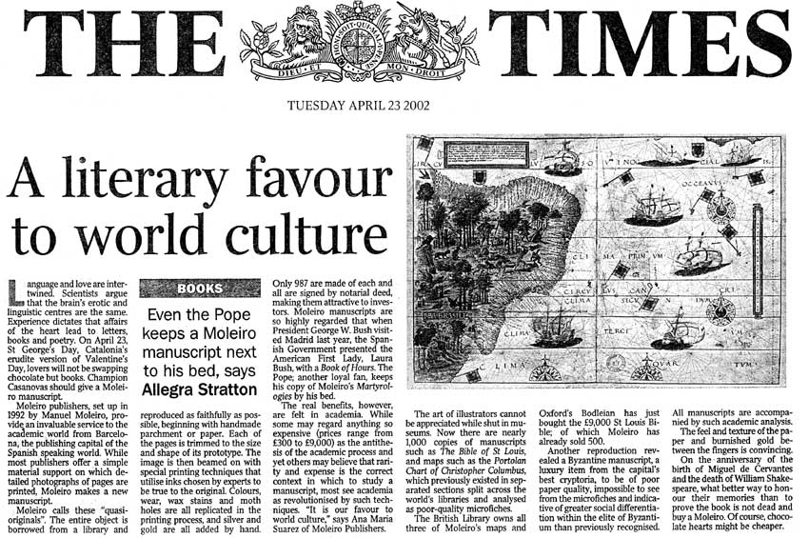
Some people say the English are always cold and reserved, some believe the English eat porridge for breakfast and read THE TIMES every day.

Slide 3

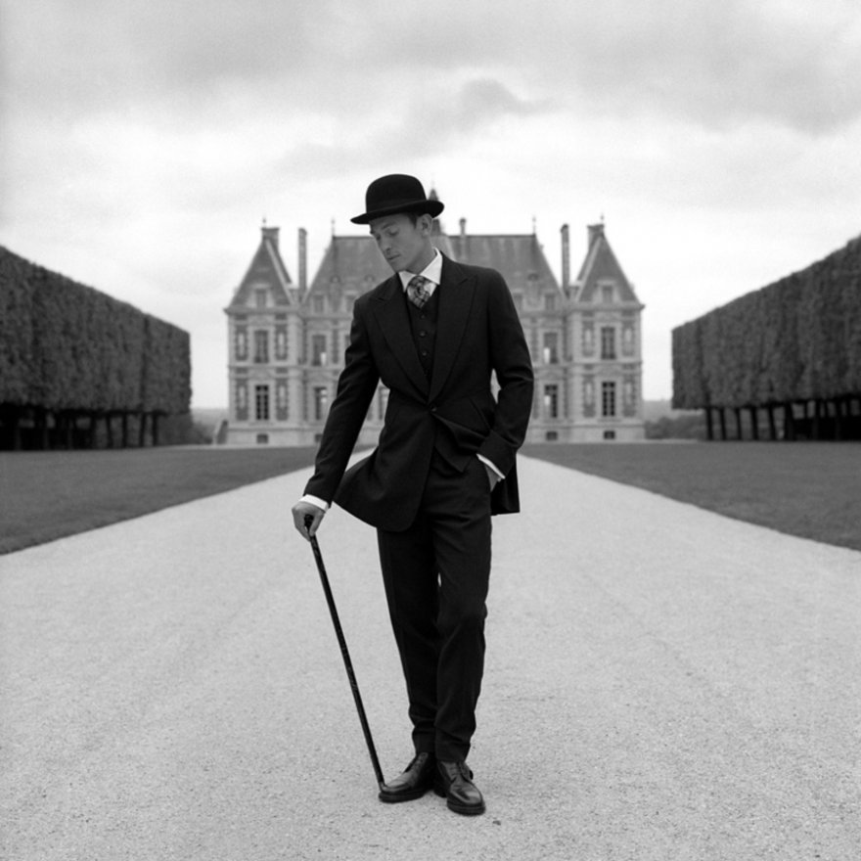
Many Australians belive that the English always whine and call them ‘’whining poms’’.

Slide 4

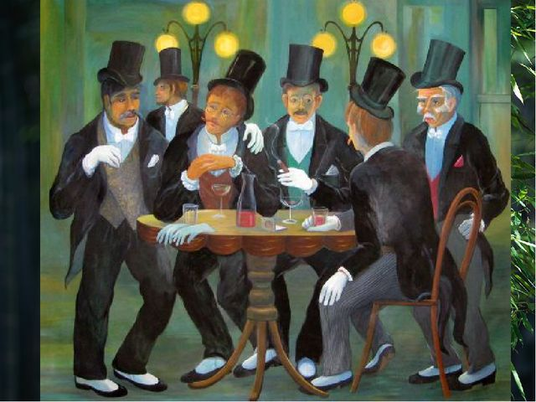
The Welsh, Scottish and Irish think the English are like with reference to the British Empire.

Slide 5

There are three things that people most closely associate with the
English.

Slide 6
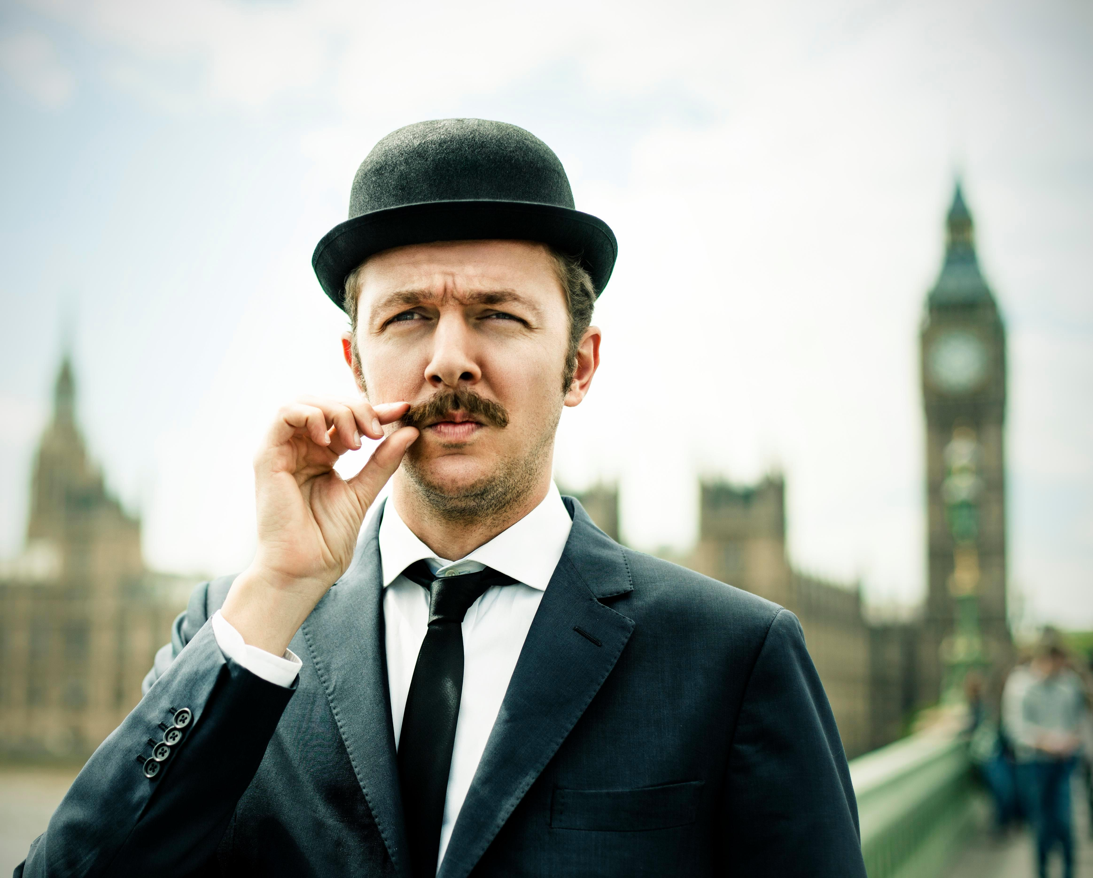
Sherlock Holms,
good manners
and politeness.

Slide 7
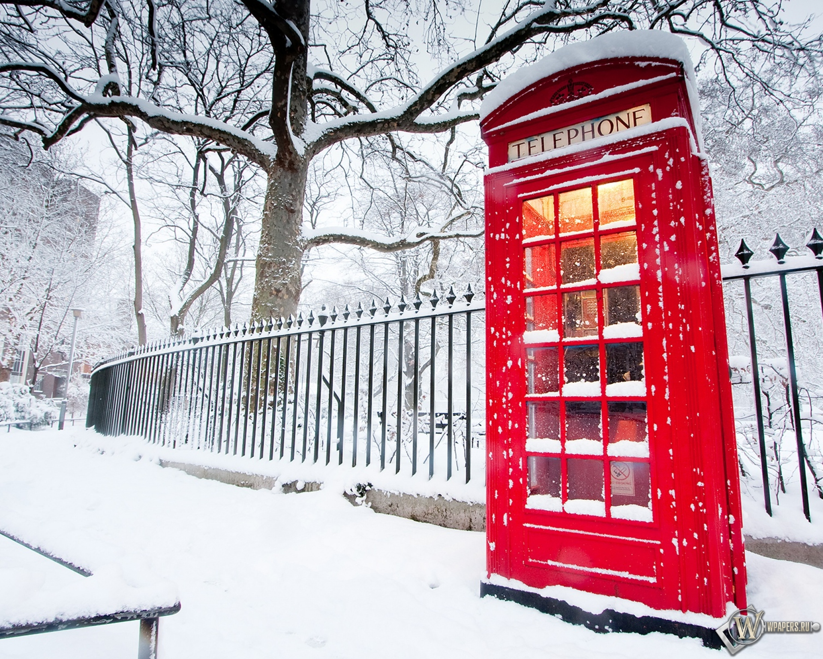
Red double-deckers,
the Royal Family
and the BBC.

Slide 8
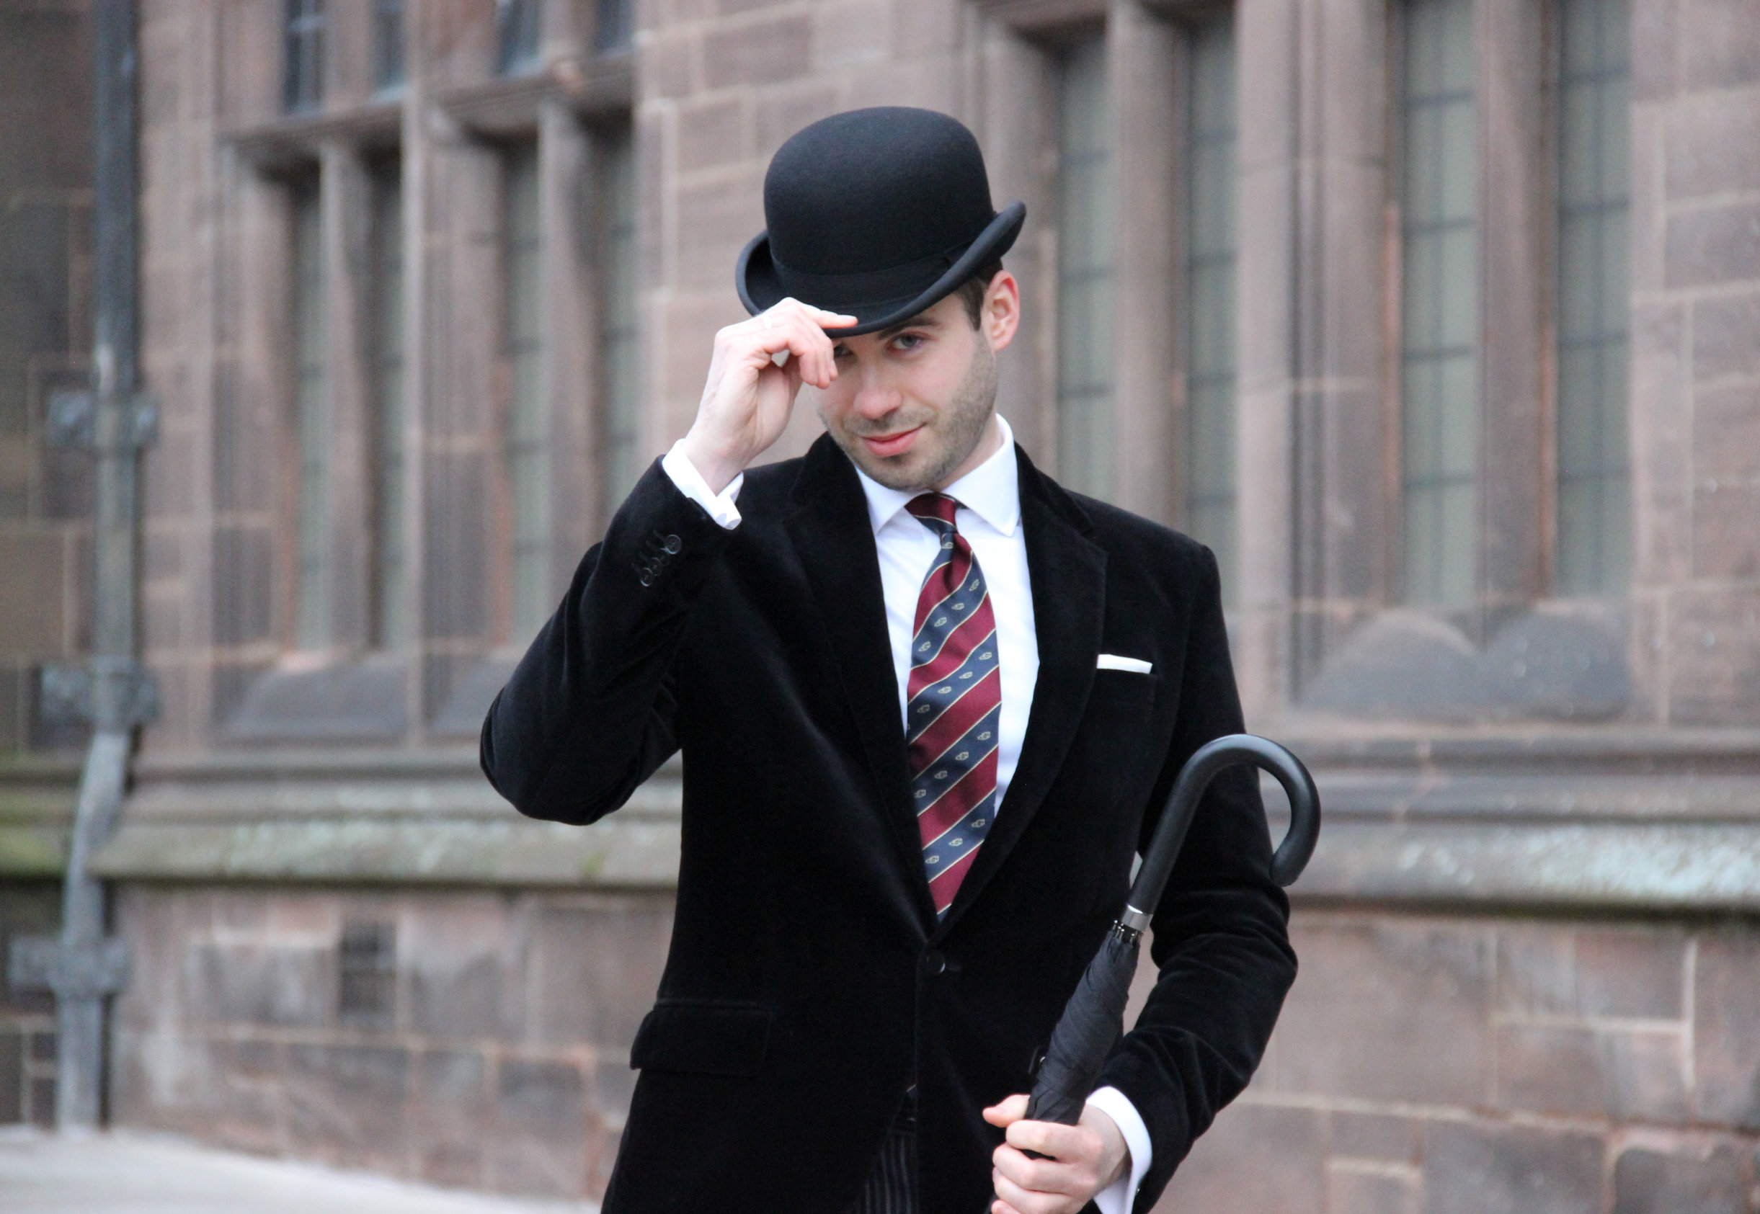
Eccentricity, sense of
superiority
towards
foreigners,
fish and chips,
reserve.

Slide 9
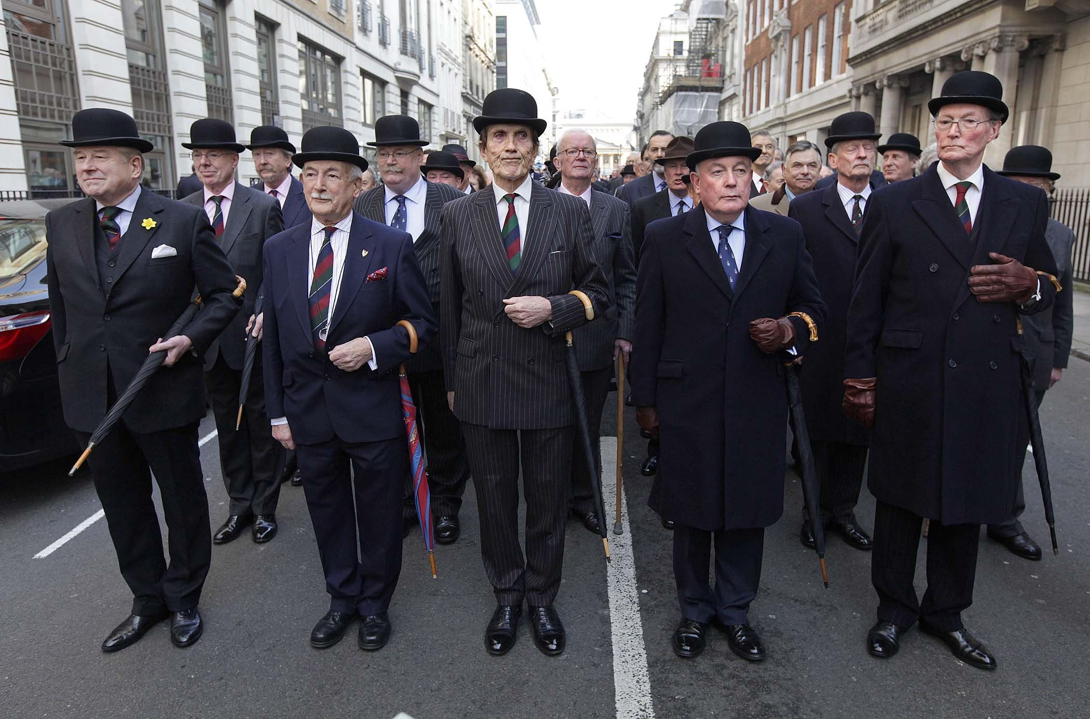
Sense of humour, cricket, stiff upper lip.

Slide 10
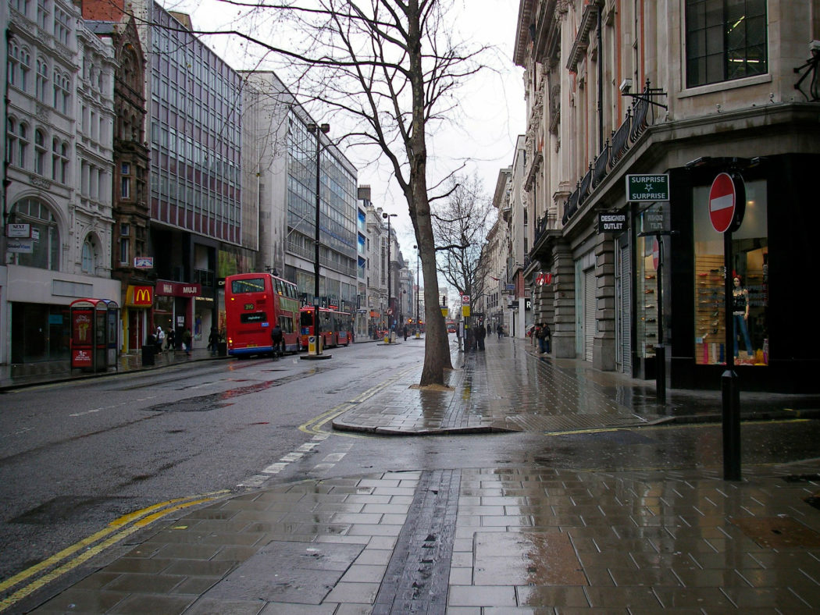
The English are very cold, the food is horrible and the weather is too cold and wet.

Slide 11
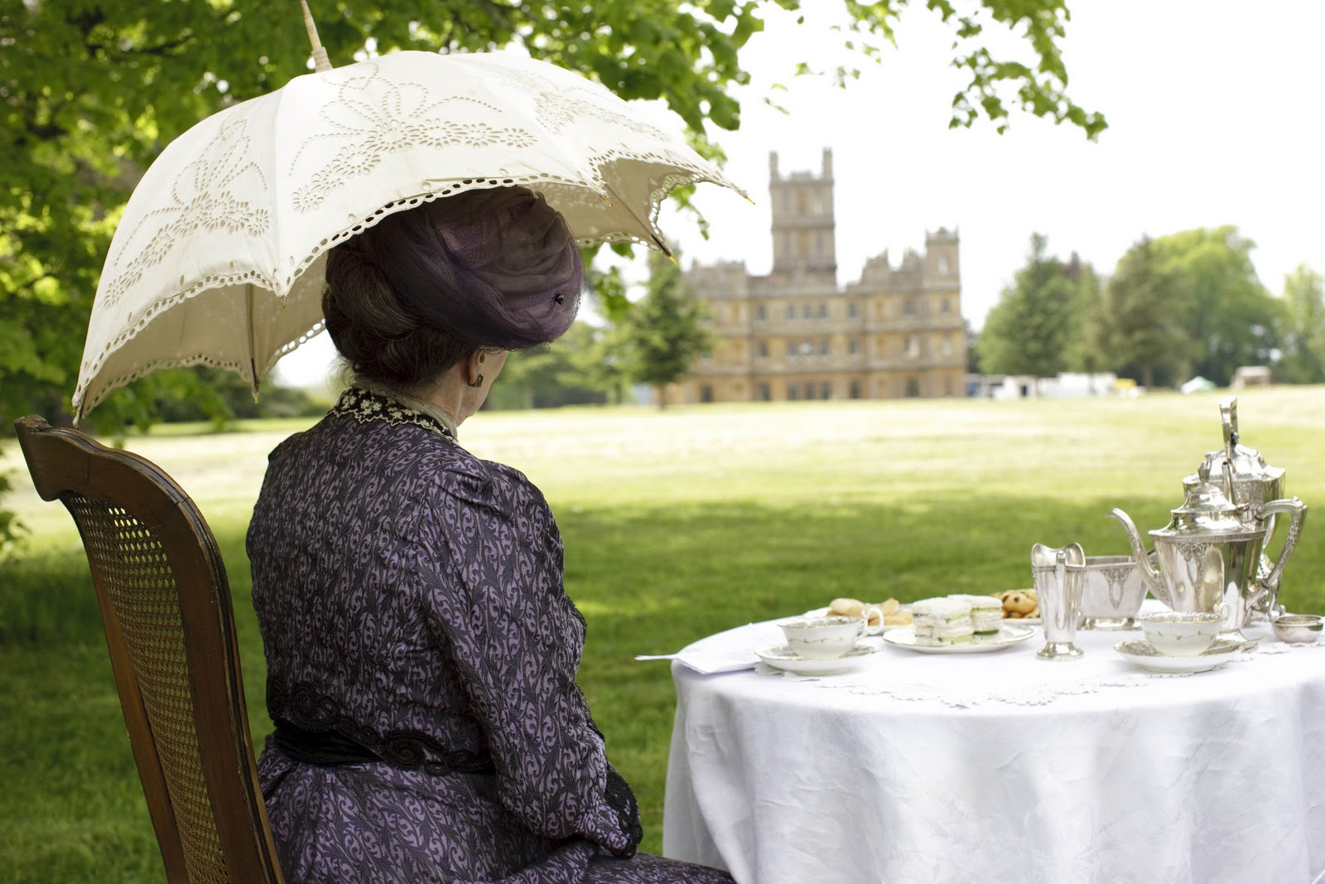
So, is all this true? Yes and no.

