Slide 1
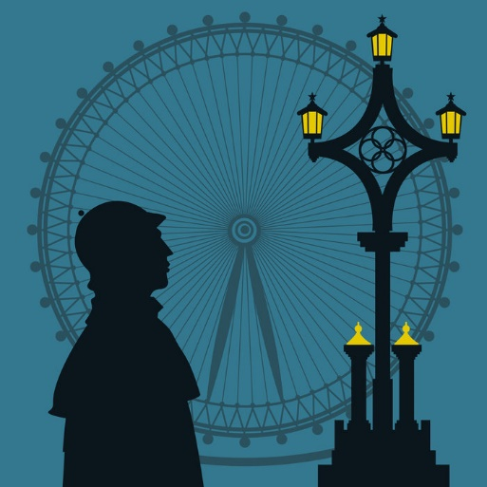
IMPRESSIONS
OF
LONDON
Выполнила:
учитель английского языка
Кузовова Карина Геннадьевна

Slide 2
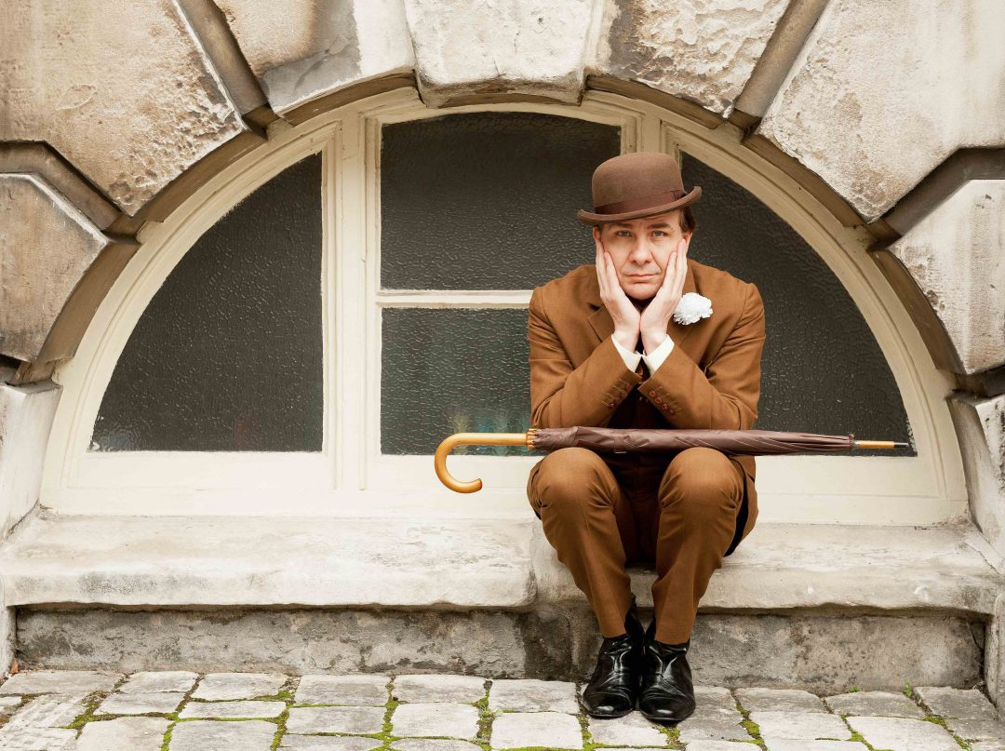
What are foreigners usually taught before they travel to Britain?
First of all, they told that the English tend to be rather stiff, snobbish and suspicious of foreigners. BUT Julia’s (my friend) experience makes her doubt its accuracy.

Slide 3
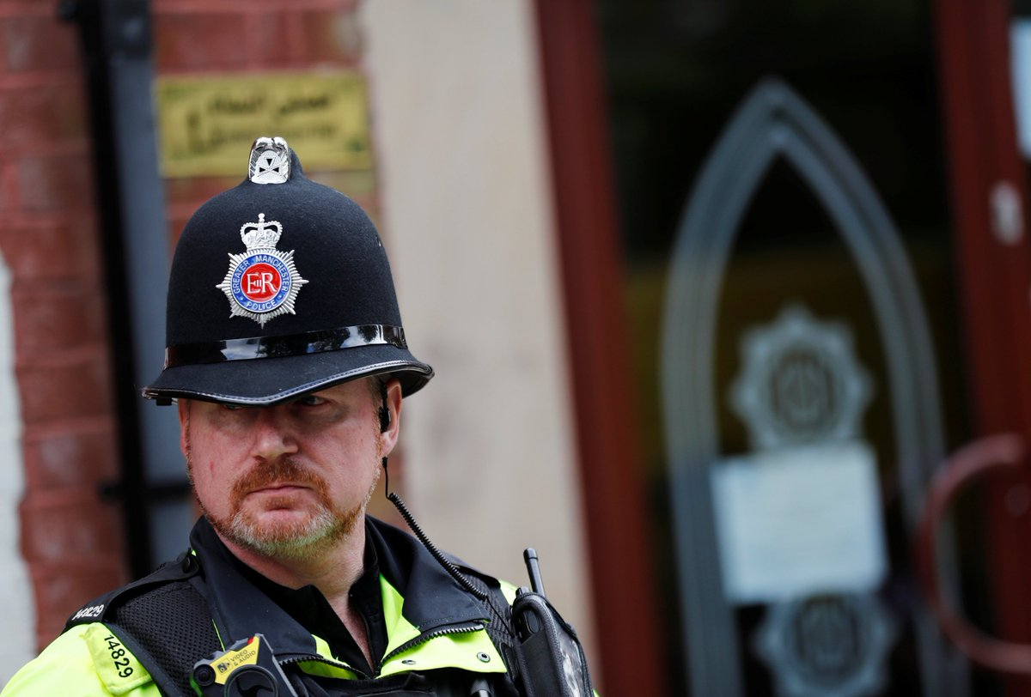
Take a policeman – a symbol of power in any country.
The one Julia met in Covent Garden gave her a happy smile and readily agreed to pose for her. He showed NO SIGNS OF SUSPICION!!!
Another bobby allowed her to take a photo of him against the Houses of Parlament.

Slide 4
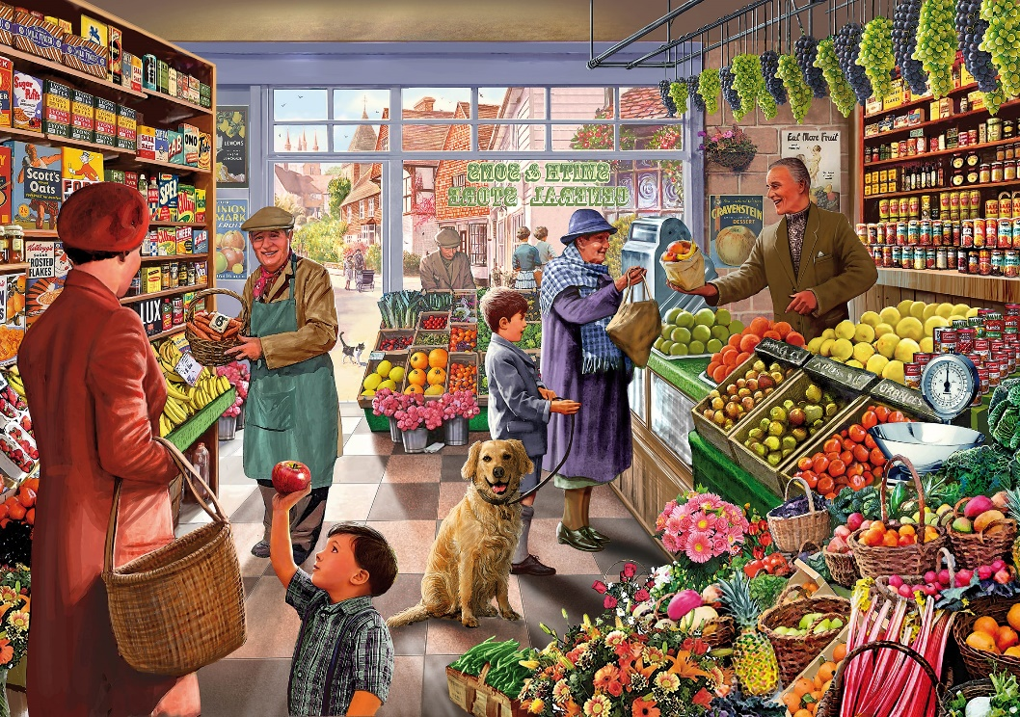
Another time it was a greengrocer.
He was proud to demonstrate his huge potatoes. He eagerly let her take his photo and seemed neither stiff nor suspicious.

Slide 5
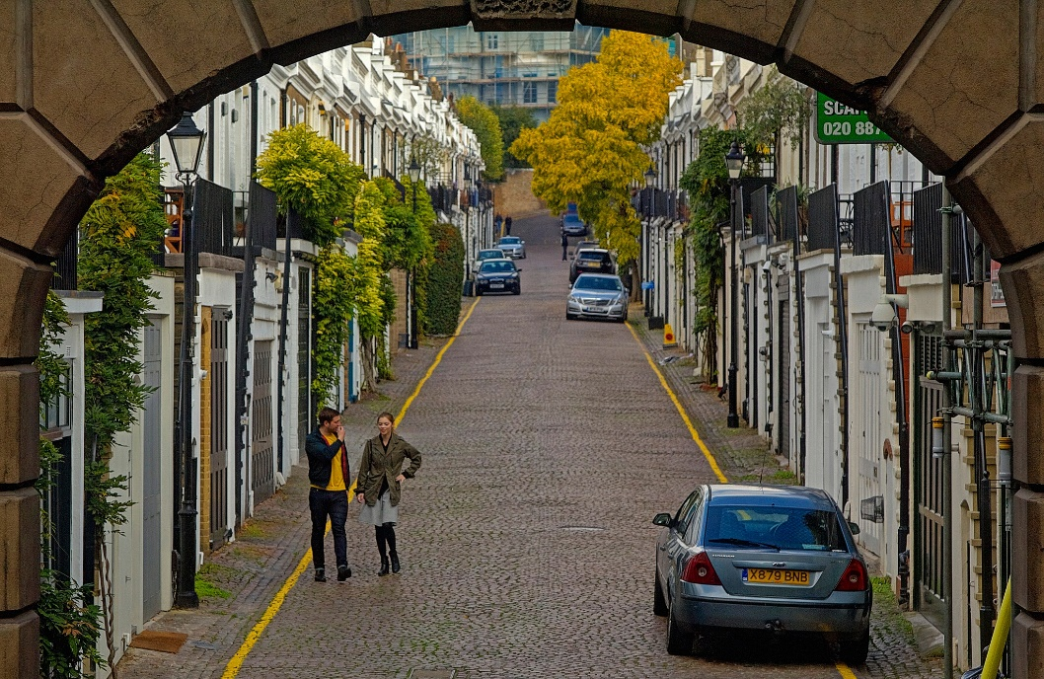
One Londoner saved my friend when she got lost.
Poorly lit streets are so typical of central London.
It was raining and no wonder there was nobody in sight.
Julia felt like crying.

Slide 6
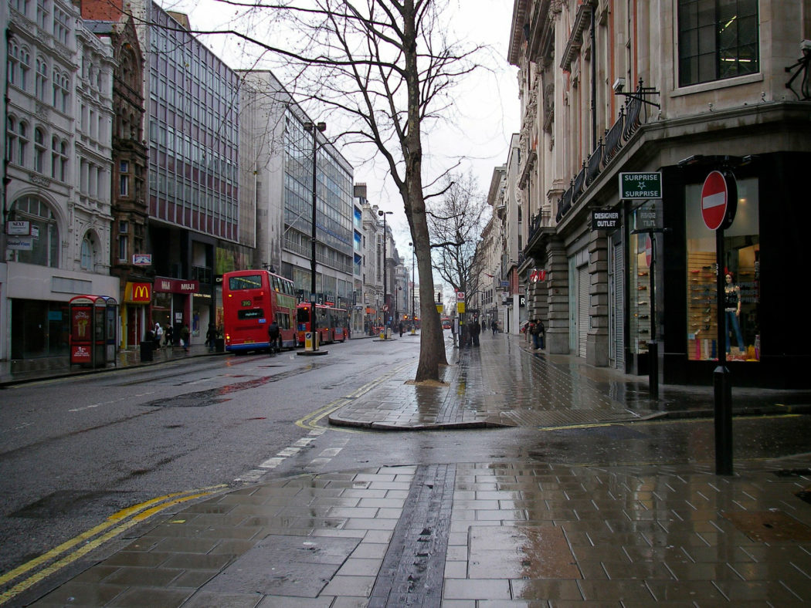
Suddenly a man appeared as if from nowhere.
He was jogging in her direction.
He showed her the way and followed her to the station.

Slide 7
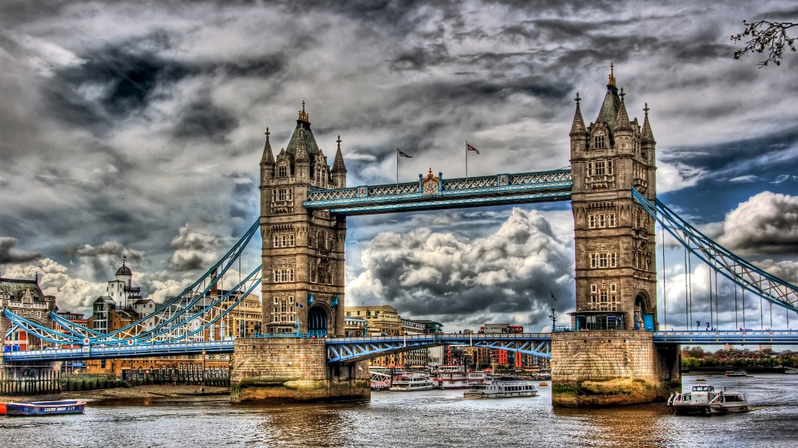
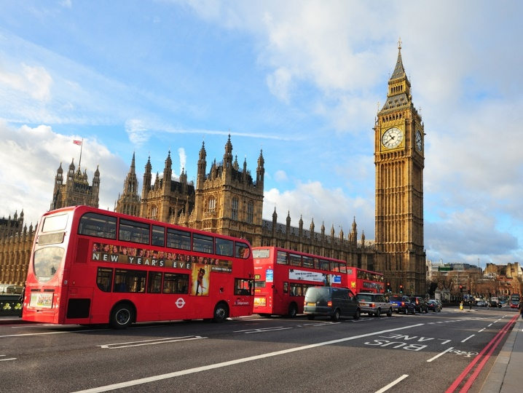
Could anything like that happen in your city/town?

