Slide 1
Do you have an example to follow?

Slide 2
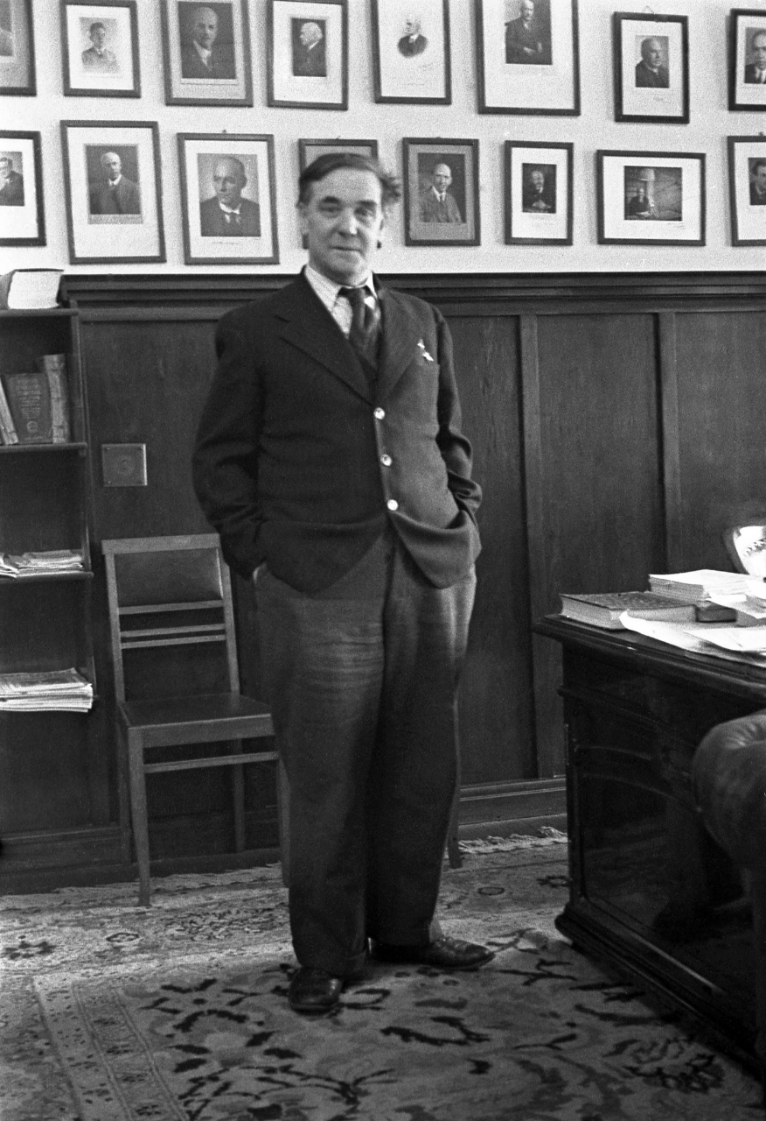
Petr Kapitsa was a great Russian scientist
He was a leading Soviet physicist and Nobel laureate, best known for his work in low-temperature physics.

Slide 3
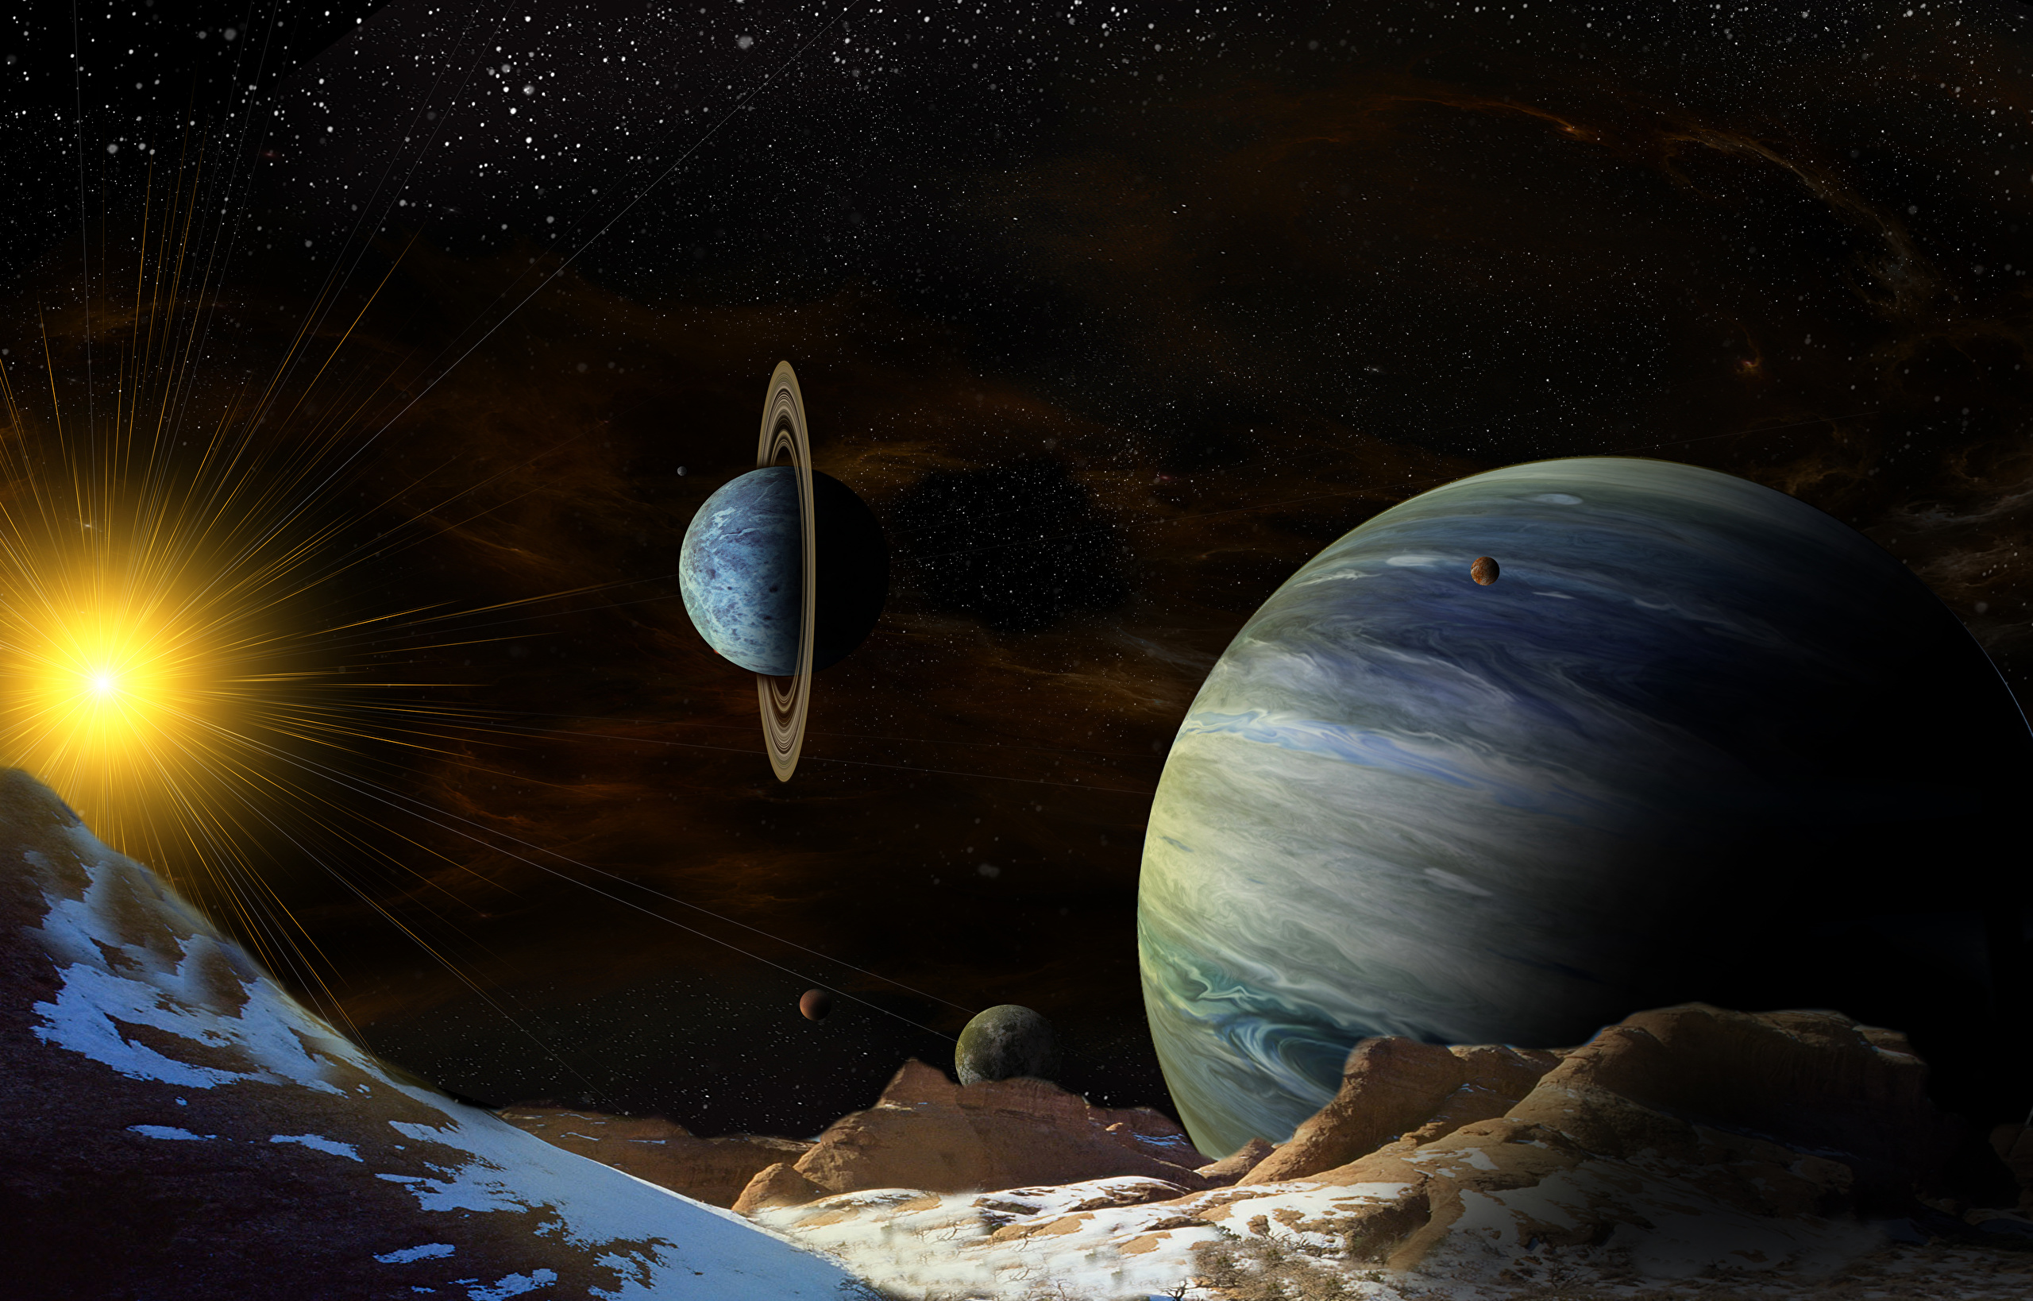
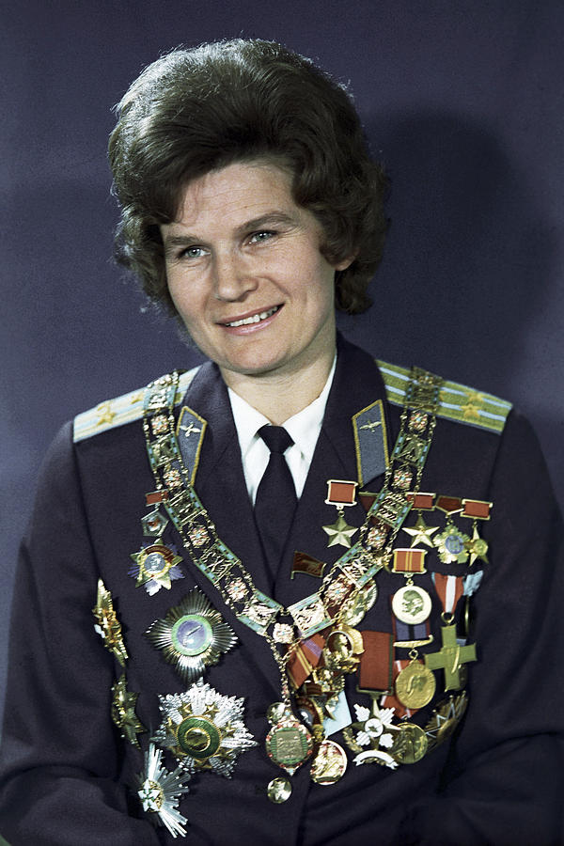
Valentina tereshkova
She is the first and youngest woman to have flown in space with a solo mission on the Vostok 6.

Slide 4
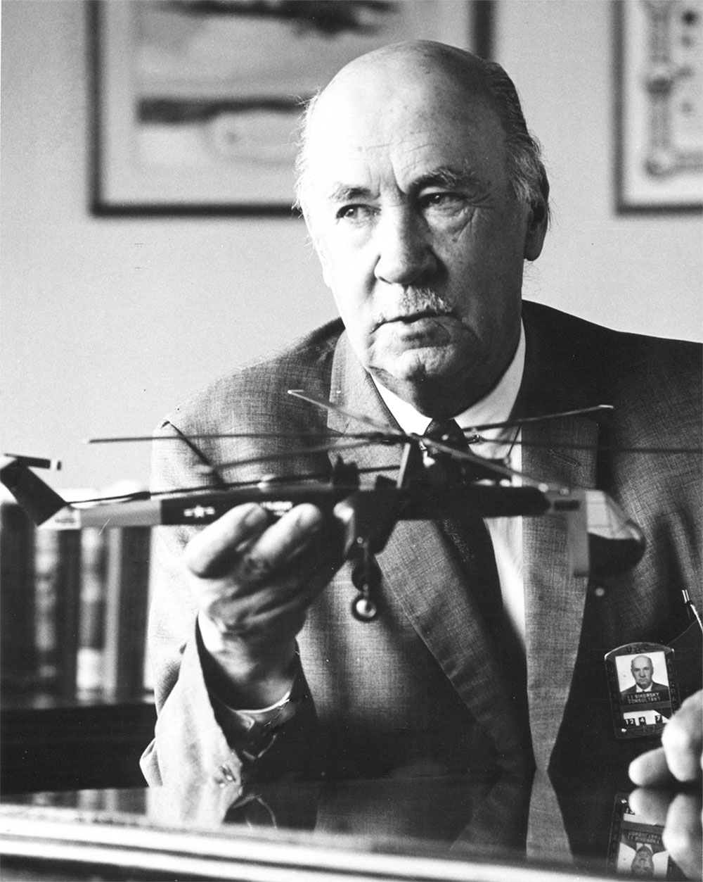
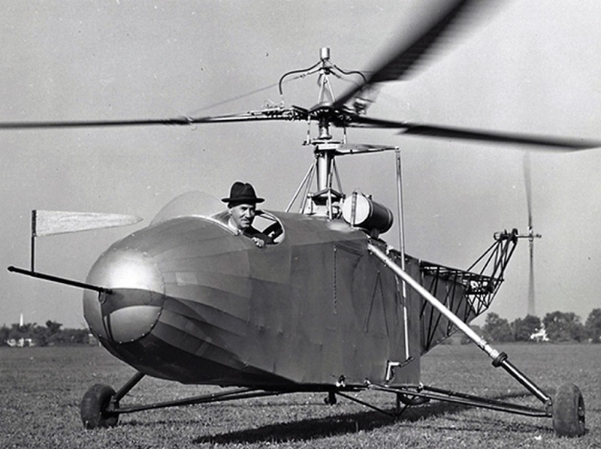
Igor sikorsky
In May 1909 he began designing his first helicopter.

Slide 5
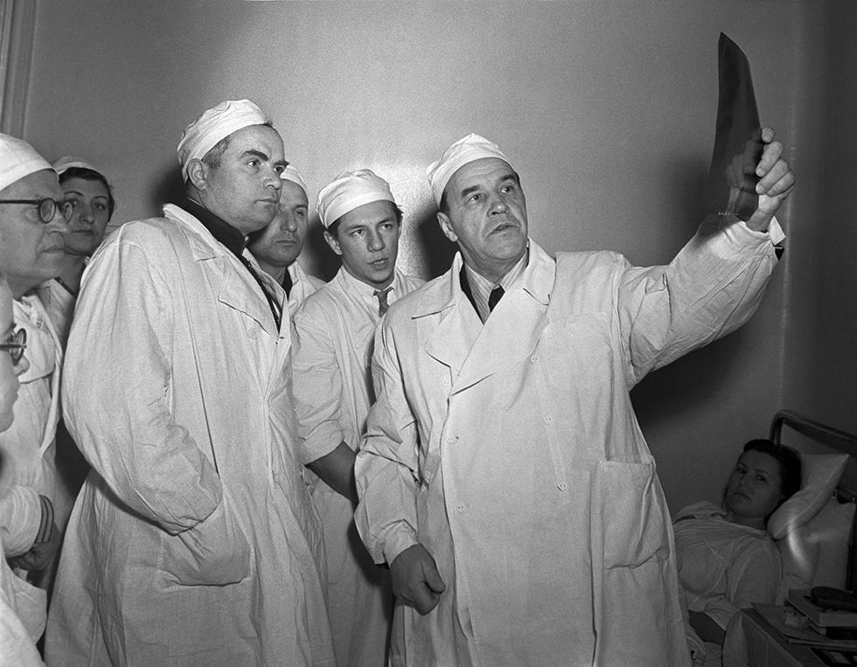
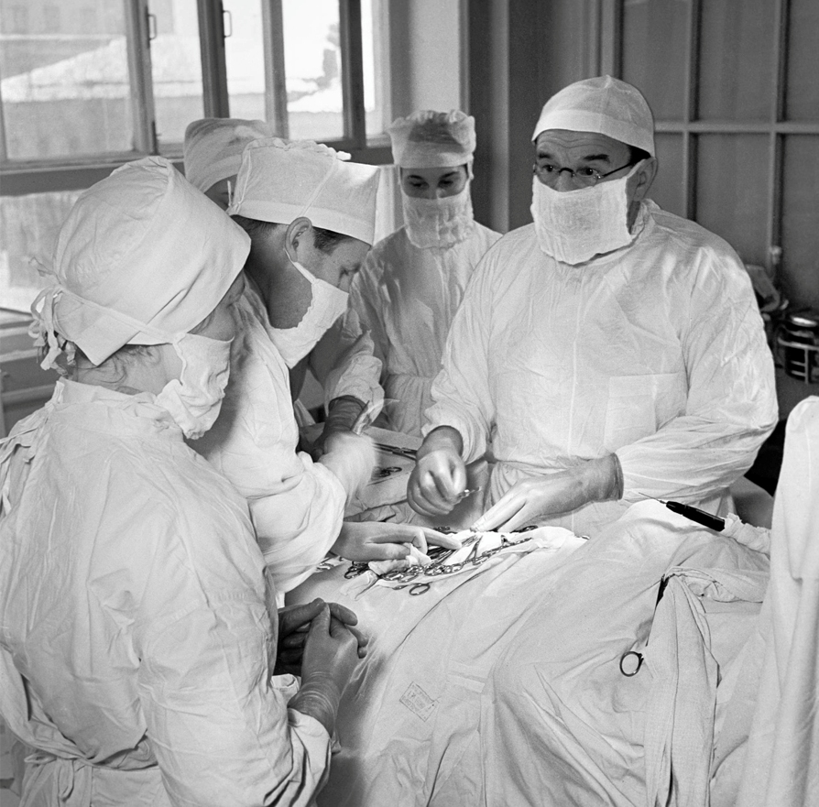
Alexander bakulev
was a surgeon, one of the founders of cardiovascular surgery.

Slide 6
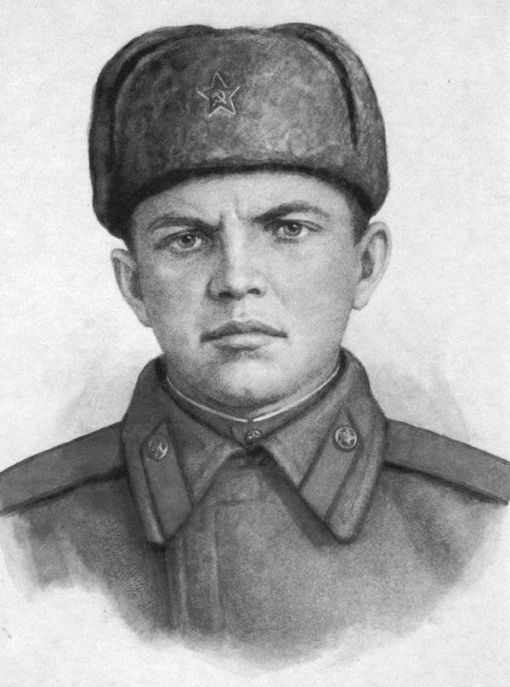
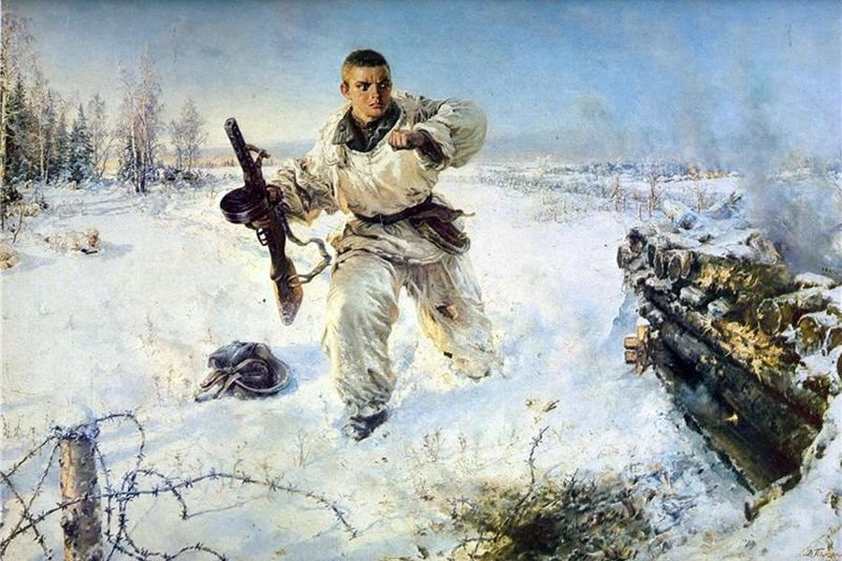
Alexandr matrosov
was awarded the title of the Hero of the Soviet Union for blocking a German machine-gun with his body

Slide 7
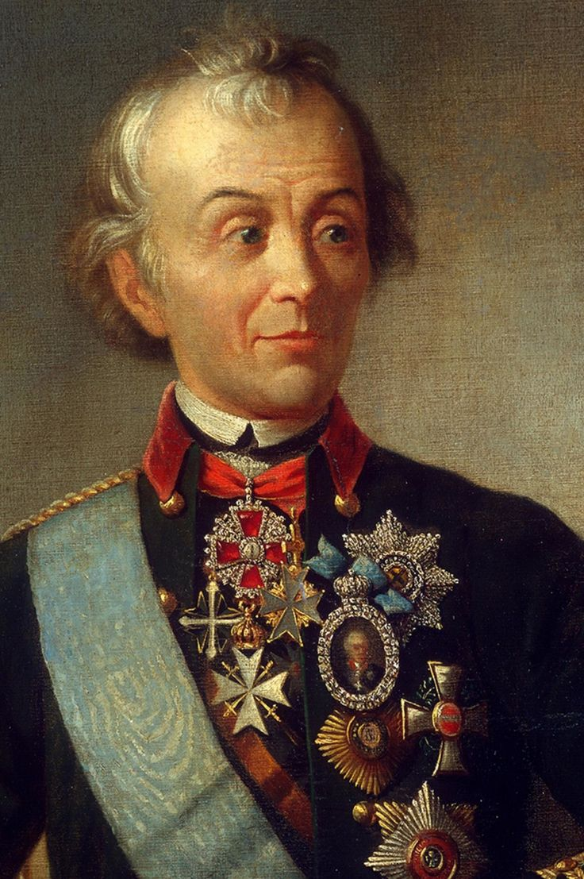
Alexandr suvorov
was a Russian military leader

